Slide 1
Chapter 6
Visual Perception

Slide 2
Perception of Depth Perception of Motion Perception of Color

Slide 3
Perception of Depth
Visual cues provide depth information
Monocular – cues that require only one eye
Stereo – cues that require or benefit from both eyes

Slide 4
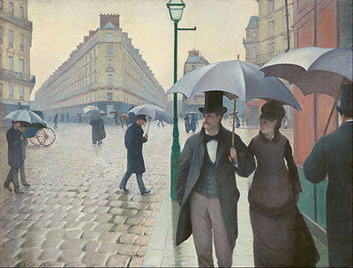
Paris Street, Rainy Day,” Gustave Caillebotte,1877. Art Institute of Chicago

Slide 5
Monocular perception
In principal it works by comparing relative objects visible size based on some known or assumed size
The closer an object the larger it is on the retina
Shape and texture are additional cues

Slide 6
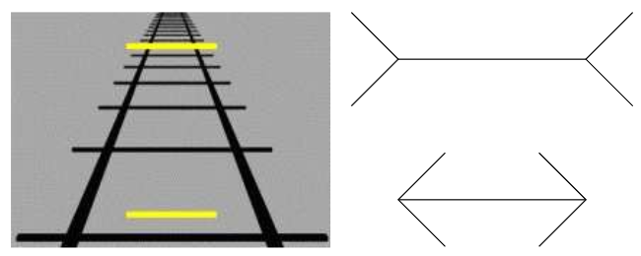
Monocular illusions

Slide 7
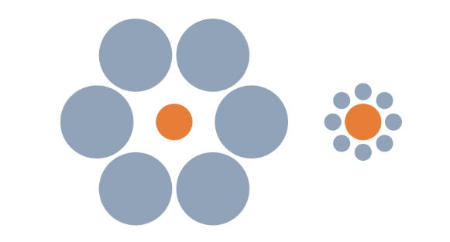
Ebbinghaus illusion

Slide 8
Monocular Perception Cont.
Hight in visual field – objects as they approach the horizon appear to be larger and further away in-spite of their identical size
Accommodation – youths given up-to 10 Diopters of variance can bring objects in and out of focus this ability diminishes due to aging

Slide 9
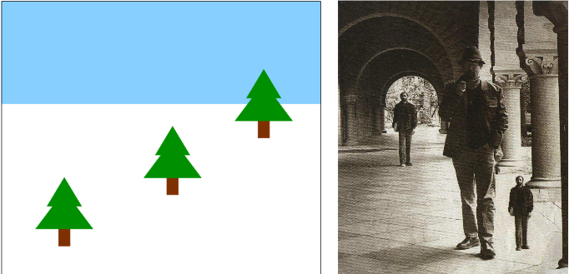
Example of horizon playing a role in depth perception Size change based on proximity

Slide 10
Monocular Perception cont.
Motion Parallax – objects in the foreground move quicker relative to objects the background using time to “fake” stereo vision

Slide 11
https://stonetree-world.tumblr.com/post/151700717208

Slide 12
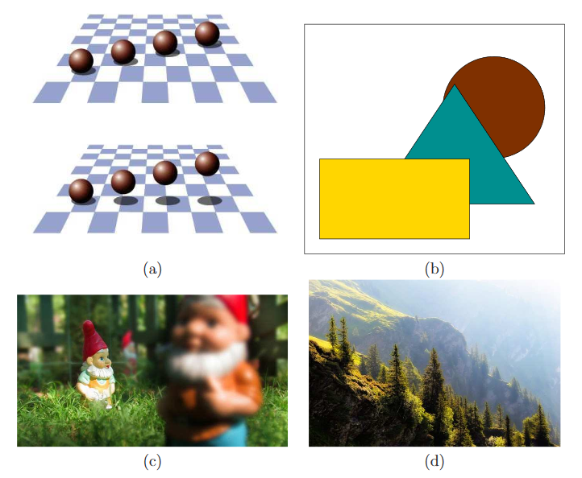

Slide 13
Stereo Perception
Horopter – The space in which both eyes converge on an object
binocular disparity – The phenomena where the brain must resolve 2 distinct images one from each eye
Diplopia – the name of the effect easiest to notice for close objects but holds true for far objects when focusing on something close

Slide 14
Perception of Motion

Slide 15
Motion Detection Mechanisms
Reichardt detector – neurological system that detects a change in an object’s position looking for object placement
Object motion vs Observer Motion
Saccadic suppression(Chapter 5.1) – the suppression of visual signals while moving
Proprioception – the bodies’ knowledge of how it is moving based on motor commands including eye muscles
Overall Scene movement compared to object’s moving

Slide 16
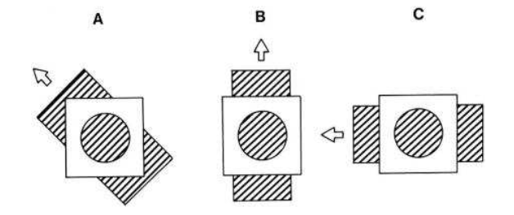
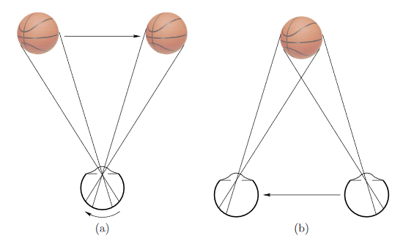
Issues with the Reichardt Detector
All examples produce the same motion effect inside the circle
If the observer moves or the object moves the image on the retina produces the same effect

Slide 17
Stroboscopic motion
Stroboscopic / apparent motion – the effect of flashing different images to allude to movement
Zoetrope – a drum with slits opposing images on the inside that produces a stroboscopic motion picture when rotated.
Beta movement – cycling dots around 2fps images seem to pop over
Phi phenomena – cycling dots higher than 15fps dot seems to move through the pattern

Slide 18
See beta and phi movement example

Slide 19
Motion and Framerate
2 Stroboscopic apparent motion starts
10 Ability to distinguish individual frames is lost
16 Old home movies; early silent films
24 Hollywood classic standard
25 PAL television before interlacing
30 NTSC television before interlacing
48 Two-blade shutter; proposed new Hollywood standard
50 Interlaced PAL television
60 Interlaced NTSC television; perceived flicker in some displays
72 Three-blade shutter; minimum CRT refresh rate for comfort
90 Modern VR headsets; no more discomfort from flicker
1000 Ability to see zipper effect for fast, blinking LED
5000 Cannot perceive zipper effect

Slide 20
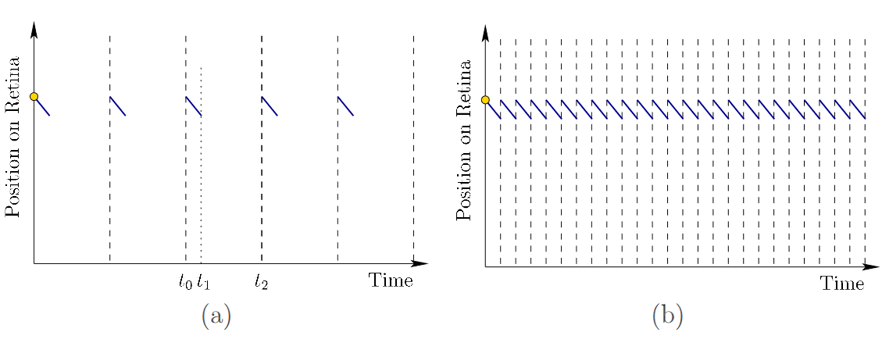
Zipper effect

Slide 21
Effects in VR
Low framerates can cause images appear to linger causing a stutter effect which can cause headaches
Framerates of 90fps or greater reduce or eliminate adverse effects for most people

Slide 22
Perception of Color

Slide 23
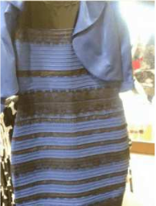
Cecilia Bleasdale
dress color illusion
Blue and black
Or
White and gold

Slide 24
Understanding Color
Dimensionality reduction – converting infinite dimensional color-space to a 3dimensional color-space the eye understands
Color space – A set of coordinates that specify a color
Mixing color – mixing 2 colors will take the weighted average of the distance between them based on the potency
Constancy – The reason for the dress illusion based on chromatic adjustment due to lighting adjustment.

Slide 25
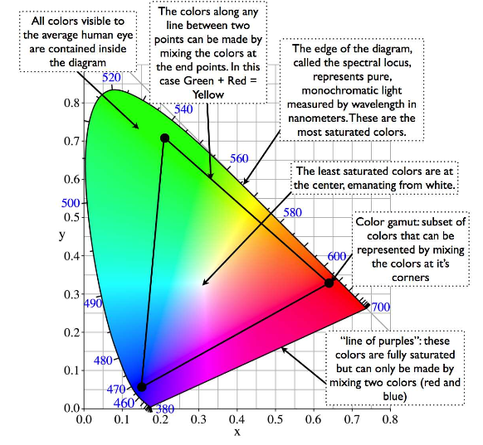
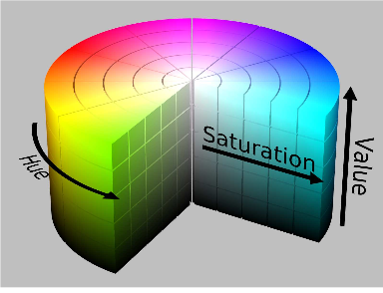

Slide 26
Display issues
Digital displays typically use the RGB color space with 256 brightness level for each color
Humans perceive 7magnitudes of brightness difference and that’s not achievable by most displays.

Slide 27
Combining sources of information
Using probability to determine the truth based on multiple inputs

